Slide 1
How good is my plot?
Data Science Project competition
Urša Zrimšek, Maruša Oražem, Andrej Hafner
Ljubljana, 22.6.2021
Notes:
Who are we - present team members
quick presentation of our project idea → create a model to evaluate plot quality, focus on the visual aspects because otherwise, we would need to know the context of the data presented in the plot, which would make the task a lot harder

Slide 2
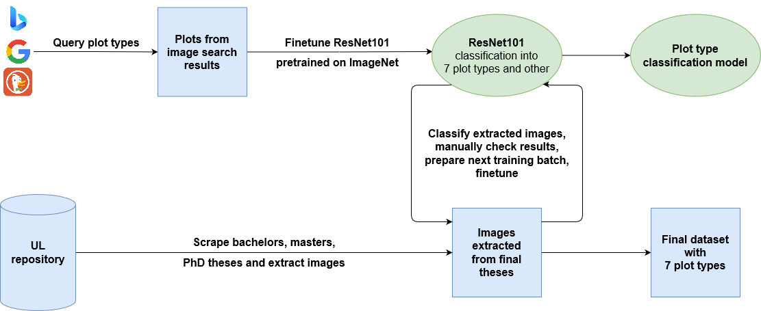
Plot type classification
Notes:
Create a dataset
Scrape the final theses on the University of Ljubljana in order to obtain a dataset of the main statistical plots → line plot, bar plot, histogram, pie chart, box plot, violin plot, scatter plots
Most of the images are not plots → build a plot type classification model
Query the Google, Bing and DuckDuckGo image search and scrape the top results → manually filter to obtain the training set
Obtain negatives (category other) with sampling from the images obtained from the final theses → most are not plots, manually removed
Finetune the ResNet101 pretrained on ImageNet to classify images into 7 plot types and other
Iteratively refine final dataset: classify images, manually check the results and fix the misclassifications, prepare new training batch and finetune again - repeated 3 times

Slide 3
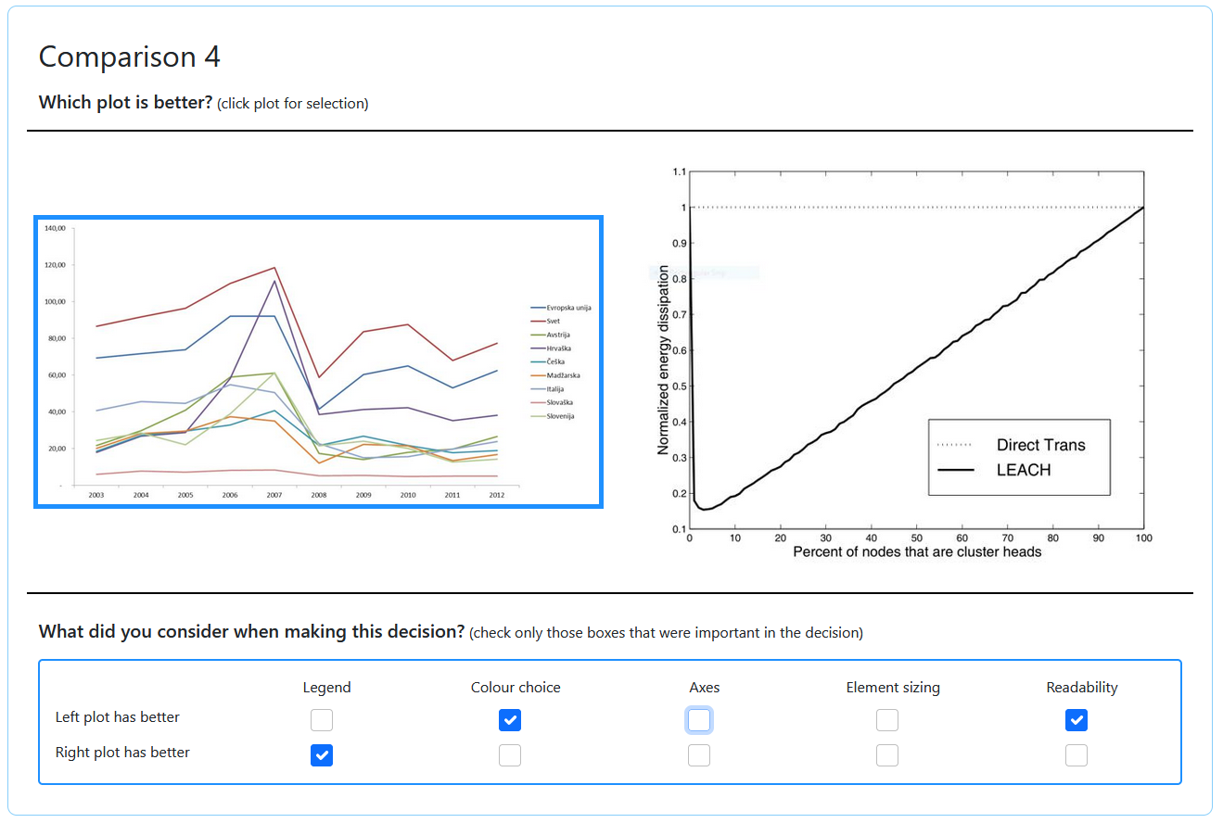
Mechanical turk
500 line plots
Swiss-system tournament
10 comparisons / HIT
9 rounds
Notes:
Utilize Amazon Mechanical Turk to evaluate the plot quality through pairwise comparisons of plots - each comparison evaluated in two stages (which is better and reasons)
Quickly reference the image of the interface for the workers
Focused only on line plots, 500 of them
Swiss-system tournament → after each round, group by points and randomly create new plots → each plot occurs only once in a round

Slide 4
Plot quality prediction
Two approaches:
Fine-tuning of ResNet101
Two types of image embeddings → PCA dimensionality reduction → regression models
Embeddings from ResNet101 pretrained on ImageNet
Embeddings from fine-tuned network used for plot type classification
Notes:
We used two different approaches for quality prediction, trained and tested on the data labeled by mechanical turk workers. The first one was finetuning the resnet101 network, and for the second one, we generated two types of embeddings - each from a differently trained network. We lowered the dimension of these embeddings with PCA and trained couple of different regression models on them.

Slide 5
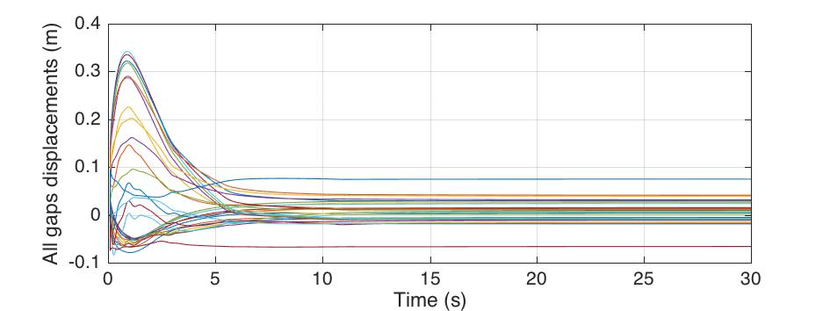
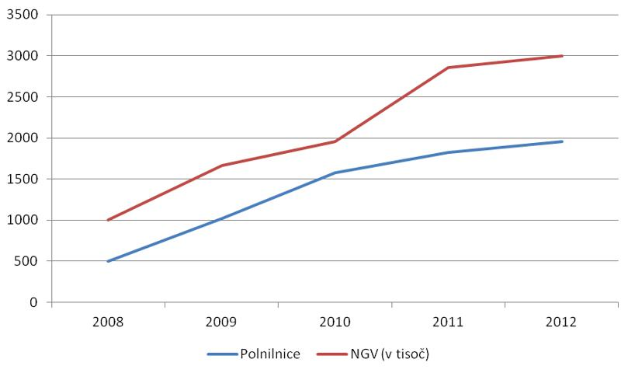
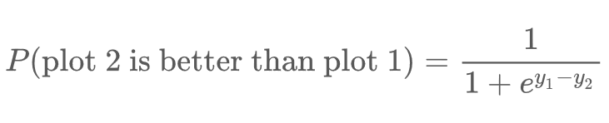
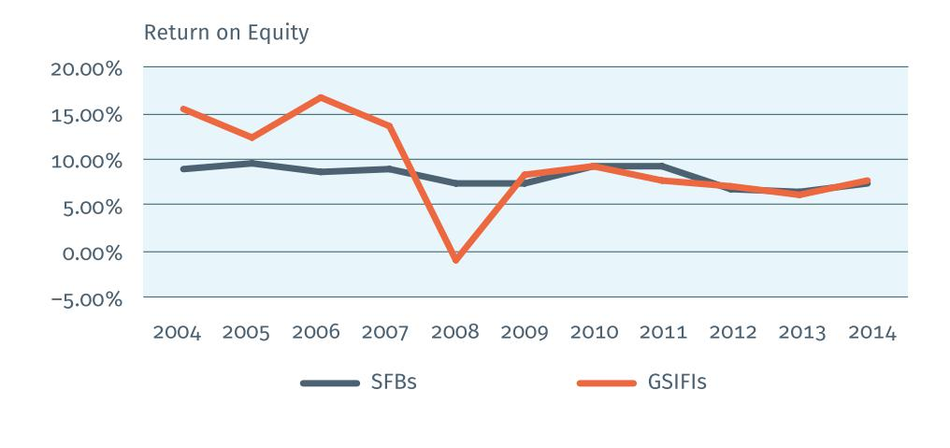
Target variable
-86
ELO ratings
inferred using maximum likelihood on pairwise comparisons
5
109
Notes:
We only got pairwise comparisons from MT, and to train regression models, we needed to change match outcomes into some rating, that will tell us the quality of each plot. We used ELO ratings. The difference between elo ratings of two plots tells us the probability of their match outcome. We obtained these ratings by fitting a maximum likelihood model on the pairwise comparisons. Here we can see some examples. On the top is the worst plot from our dataset that got a rating of -86, in the middle we have a plot with median rating 5 and on the bottom is the plot that won all the matches, with rating 109.

Slide 6

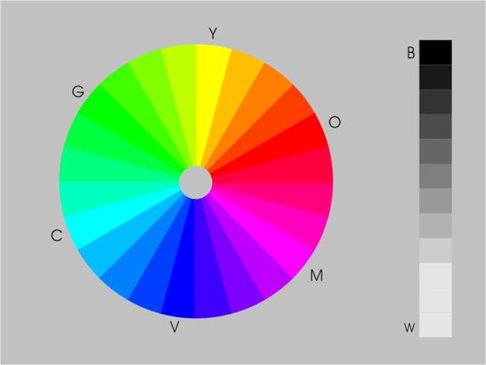
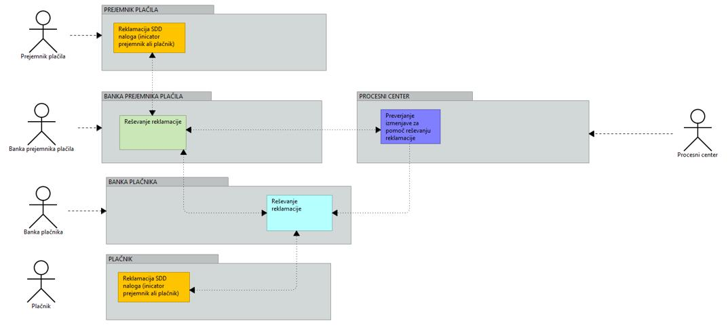
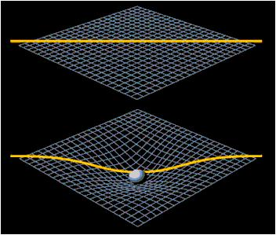
Results
PLOT TYPE CLASSIFICATION, False Positive Rates
Scatter plot 0.04 %
Bar plot 0.06%
Pie chart 1.03%
Line plot 0.2%
Histogram 8.33%
Box plot 31.25%
Violin plot 90.1%
Notes:
Here we can see the results of plot type classification. For some type of plots it worked really well and for some did not. The problem was in the number of the training instances - we had less box plots and violin plots. We could not improve the performance of the classificator, because those two types of plots rarely appear in the final theses we scrapped. Here we can see some examples of the plots that were incorectly classified. Two plots at the top right were classified as pie charts, the one in the corner was suppoused to be violin plot, and the left box plot.

Slide 7
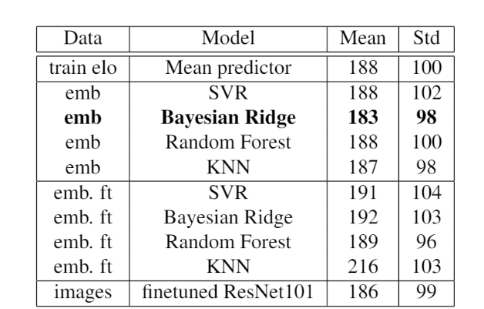
Results of quality prediction
No improvements of mean predictor.
Too small dataset.
Too subjective rating.
Notes:
Here you can see the results on our data set on different models. Every model behaves similarly to the mean predictor, so our results are not good. We think that this happened because of the dataset - it is probably too small for the models to actually learn something. The problem could also be in the subjective opinions. There is no universal definition of what a good plot is and different things attracts different people. This might be too different for every individual, that it could not be modeled.

Slide 8
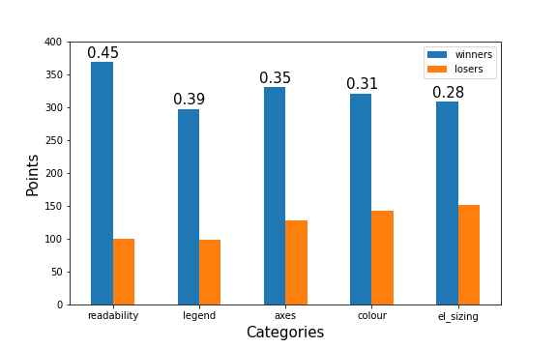
Analysis of the categories
Notes:
At the end, we have also analised the categories people selected in the surveys. On the plot we can see how many times each category was selected for the winner plot and how many times for the plot that lost. At the top of each category is written the number that represents the correlation between this category and the winners. We can see that the correlation is the highest for the readability of the plot, so we concluded that this is the most valuable category on which people decided that the plot is good.

Slide 9
Conclusions
Classification model - good for some types
Model for quality prediction might be improved with bigger data set
Plots should be readable
Notes:
So our final conclusion is that the classification model is good for some type of plots, but should not be used for box and violin plots.
The model for quality prediction is not good, but it might be improved with bigger data size.
From the analysis of the categories we concluded that plots should be made in that way that they are easy to read.

